Slide 1
ELE
Group Member Service
GMS
UDP
Logic
MUL
Global Time Synchronizer
BROA
TIM
Utils & Gadgets
Config

Slide 2
Message.json
ID: YhK7HvtYyvjbnyiFaU00FQ
METHOD: SET
SEQ: 0
CONTENT: {'MAIN_SERVER': ['172.17.112.1', 10001],
'is_member': True, 'CONTACT_SERVER': ['172.17.112.1', 10001]}
METHOD | Description
JOIN | Dynamic discovery
SET | Remote parameter setter
GET | Remote parameter getter
REDIRECT | Message forwarding
BIT | Raise bit
RMI | Remote method invocation
… | …

Slide 3
Client
…
Client
Server
Client
Client
Server
Server
…
…
Client
Client
Server
Client
…
Client

Slide 4
4. Join
Server
Server
5. Accept
Client
Server
Server
3. Assign
Server
2. Forward
1. Discovery
Client
Client

Slide 5
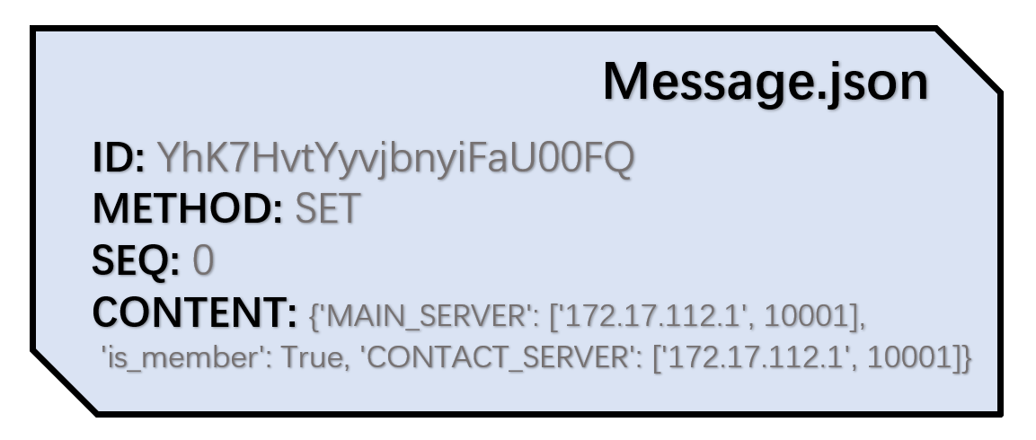
heappop
1
2
4
heappush
7
5

Slide 6
Step1
Get tiebreaker
Step2
Get Majority
Step3
Update value
Step1
Step2
Step3
Next Phase

Slide 7
Auction Component
Server
Client
Group member service
Server
Client
Global time synchronizer
Utils
Config

